Slide 1
Outreach
Midwest Region Nar-Anon
October 19, 2019

Slide 2


Step 12 invites us to carry Nar-Anon’s message of hope to Others.
Spread Awareness!

Slide 3
Objectives for Outreach 2019
Increase awareness of PDFs to download from the WSO website for Outreach use. Cost savings
Participate in WSO Outreach Calls to network with other Outreach chairpersons.
(Sharing our Mentoring information)
What do we put on Outreach tables for community events?

Slide 4
Vision Statement
We will carry the message of hope throughout the world to those affected by the addiction of someone near to them.
We do this by:
Letting them know they are no longer alone.
Practicing the Twelve Steps of Nar-Anon
Encouraging growth through service.
Changing our own attitudes.
Sharing our story.

Slide 5

Notify your community
Make information available via PSA announcement, posters, newspaper - encompassing public information, hospitals, law enforcement agencies, probation office, counselors, physician offices etc.
,

Slide 6
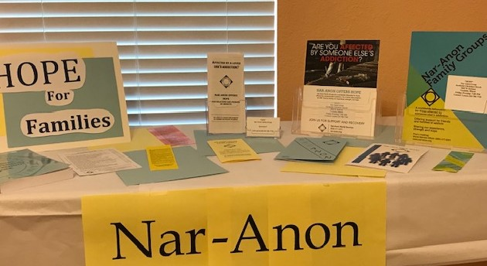
Outreach for Community Event

Slide 8


Let’s begin Today!
Sharing

